Slide 1
Baffin Bay Acoustic Propagation Study
Dr. Kevin D. Heaney
OASIS Inc.
December 3, 2015

Slide 2
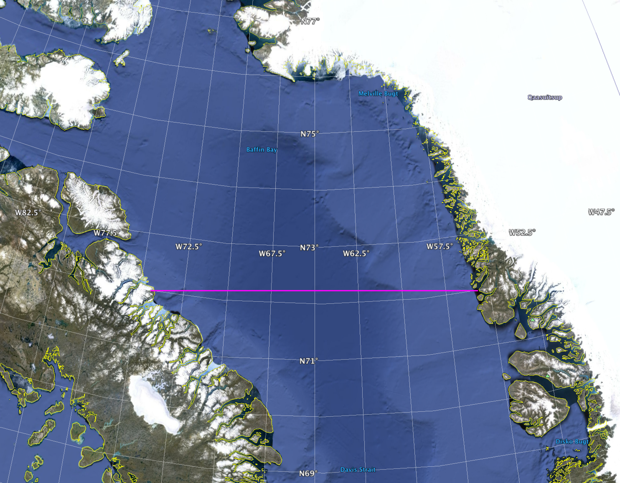
Acoustic Study
Single track modelled from 72°N
72°W based upon environmental data
Range dependent SVP used because of structural differences with World Ocean Atlas
Space/time dependent ice realization used from measured ice-thickness across the track
High angle Parabolic Equation (Peregrine) used with effective fluid-fluid model for ice with a specified ice thickness distribution (data derived pdf)
Incoherent broadband and impulse response modelled at 25, 50, 100, 250, 500 Hz.

Slide 3
Sound Speed Environment
Profile taken from CTD measurement cruise

Slide 4
Ice Distribution
Satellite measurements provide daily ice-thickness along the track. These were used to generate a monthly range-dependent pdf of ice thickness.

Slide 5
Ice Model
We will approximate the acoustics-ice interaction by placing an ice “fluid” above the water.
The PE will correctly handle the forward scattering from the density contrast and the ice roughness.
The PE will approximate shear loss with ice-volume loss.
The PE won’t handle re-transmission of shear energy back into compressional energy in the water column.
Ice layer has cp, rho, att, h(r)
Ice is random realization from observational pdf (Wadhams, or Worcester)
Ocean is World Ocean Atlas (Winter)
Sediment is Hamilton (soft)

Slide 6
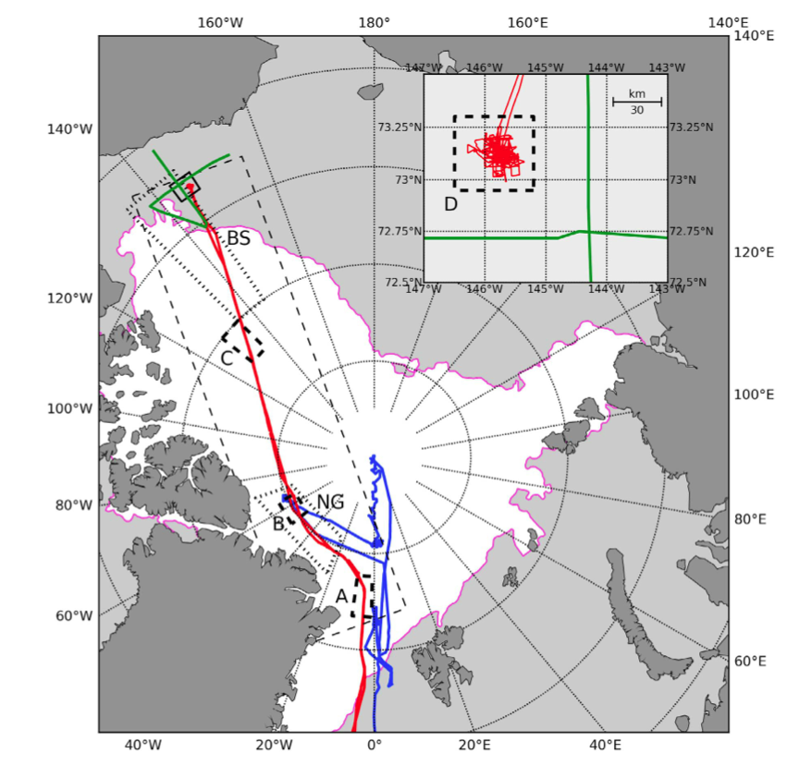
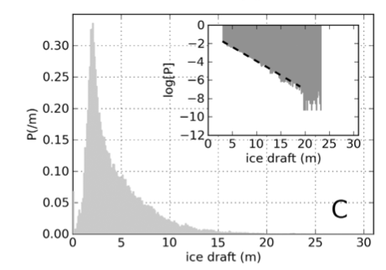
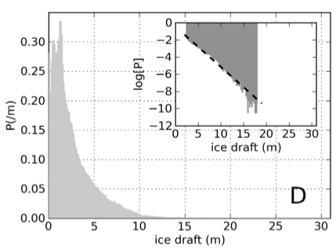
Inversion For Ice Parameter Set
Worked on two regions
Central Arctic (Multi-year ice)
Beaufort Sea (First-year ice)
Central Arctic
Beaufort

Slide 7
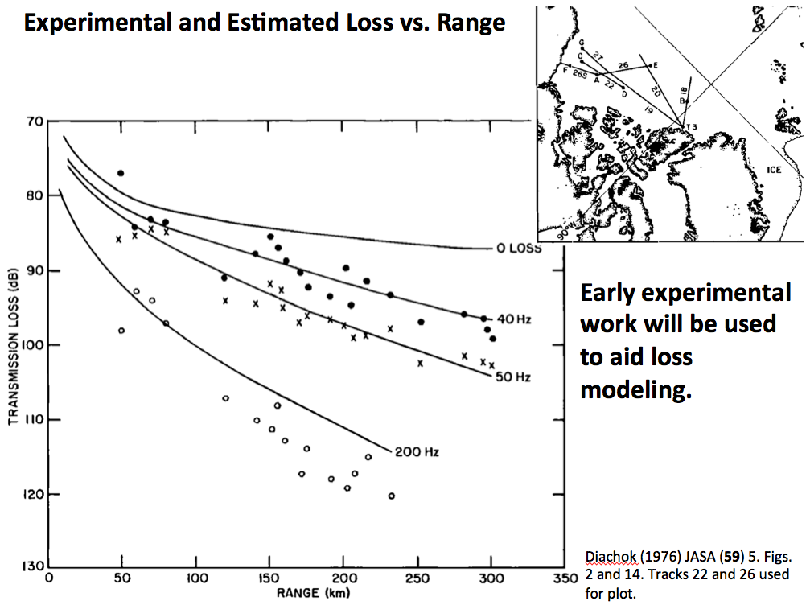
TL from Diachock
SUS Measurements from 1976 use

Slide 8
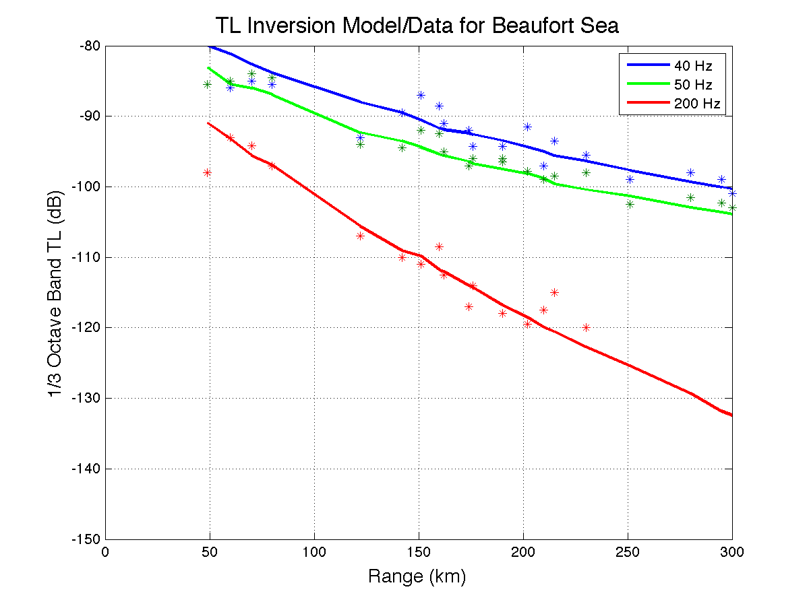
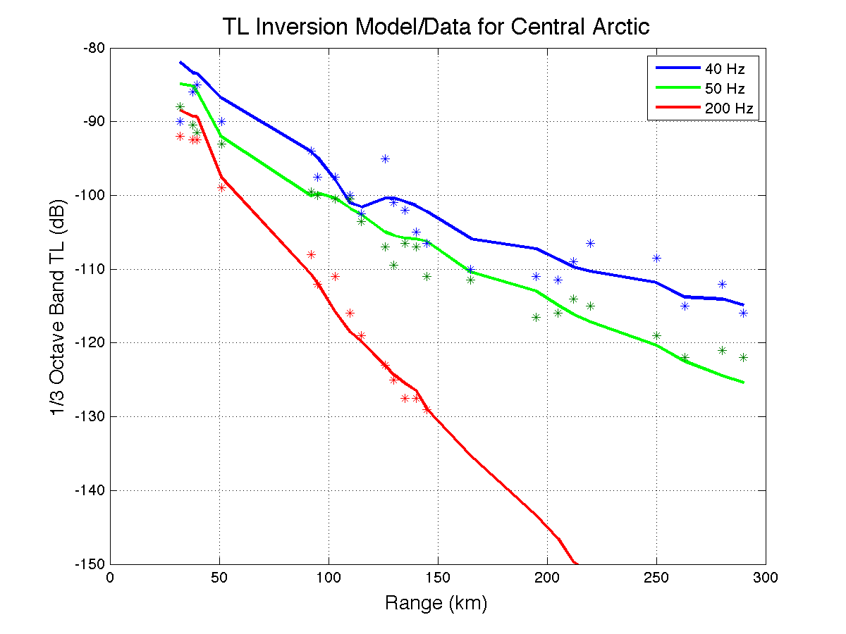
RMS Inversion Results
Beaufort Sea
Search Space:
Cp = 1400-1550
attn = 0.1-10.0 dB/m
Central Arctic

Slide 9
Broadband Incoherent TL
No Ice (October) Max Ice (March)
100 Hz
250 Hz
500 Hz

Slide 10
Broadband Impulse Response @ 375 km
No Ice (October) Max Ice (March)
100 Hz
250 Hz
500 Hz

Slide 11
Initial Conclusions
Sound channel shields propagation from ice interaction
Tomographic signal limited to modes 1-3
Source in shallow water strips most high angle energy limiting propagation to low modes trapped in sound channel
Smaller impact of ice on frequencies 100 Hz and below. Observable impact at 250Hz and significant impact at 500 Hz

